Slide 1
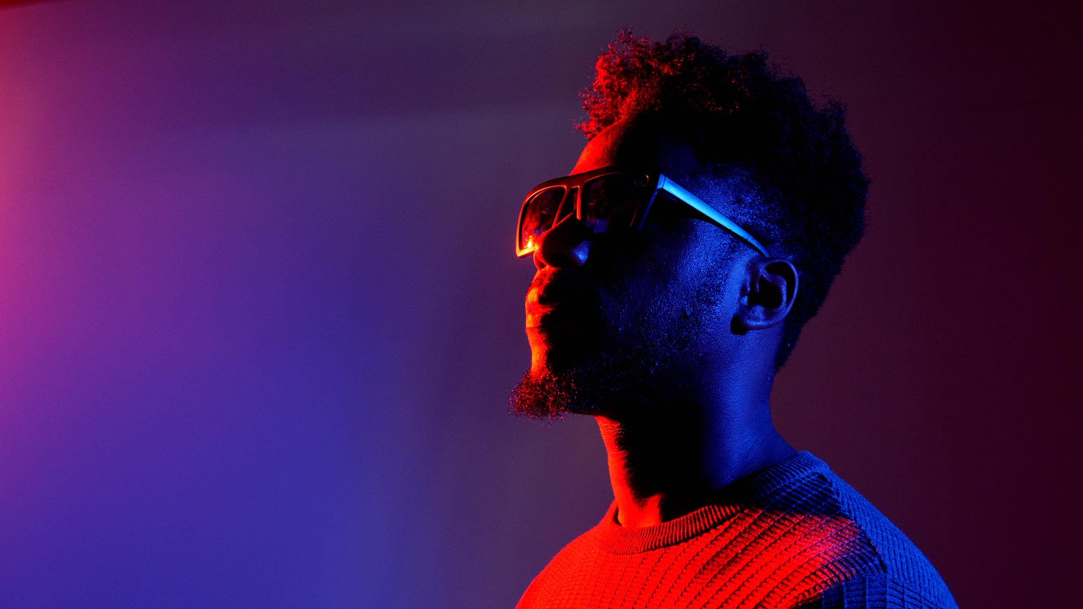

MAKING MUSIC VIDEOS

Slide 2
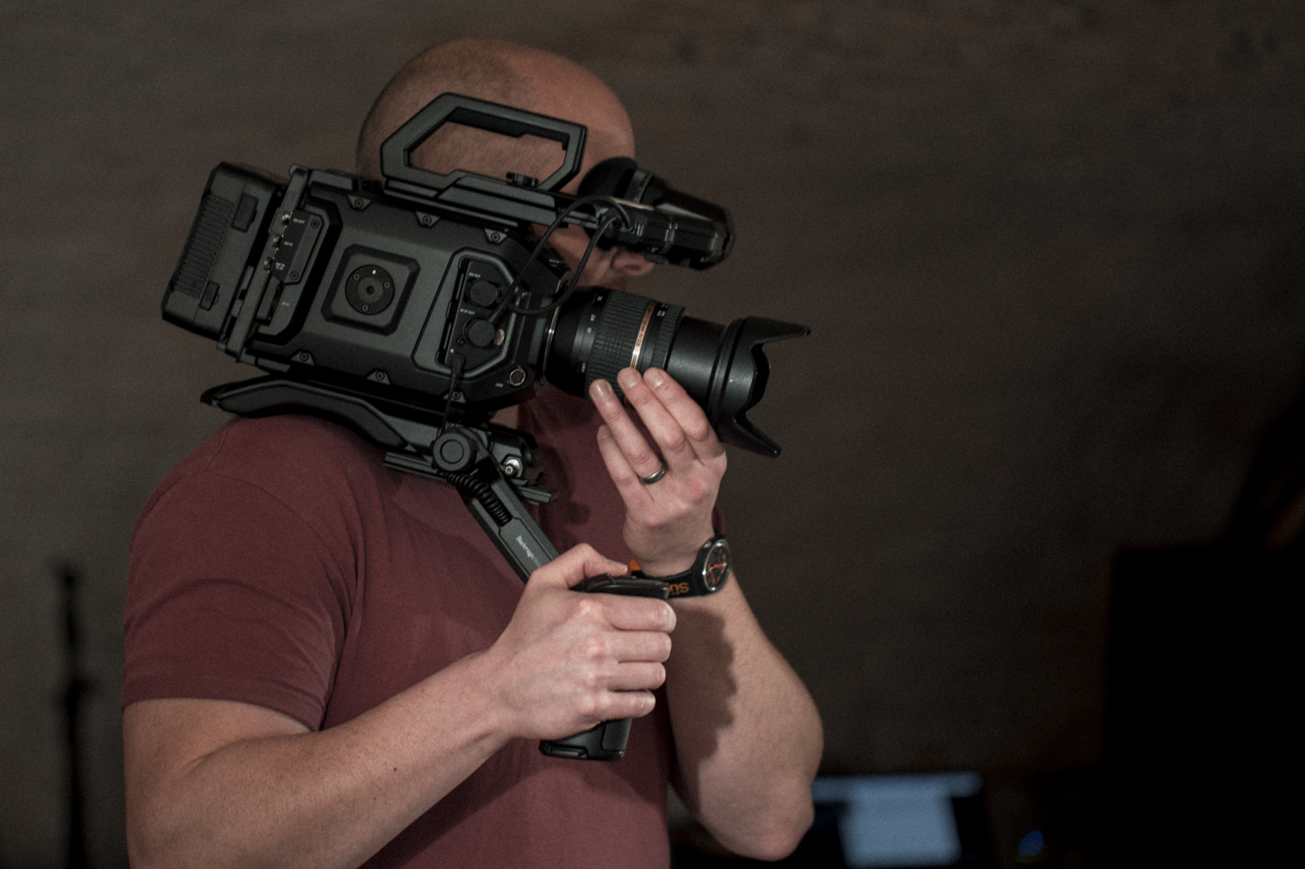
STARTING A MUSIC VIDEO BUSINESS
Make a plan
Create a great reel or body of work
Aim to get on TV – broadcast credits are a great selling tool
Offer value but don’t under sell
Be diverse
Understand trends
Experiment
Build a website
Put yourself into your business
Get insurance *yawn
Talk to people

Slide 3
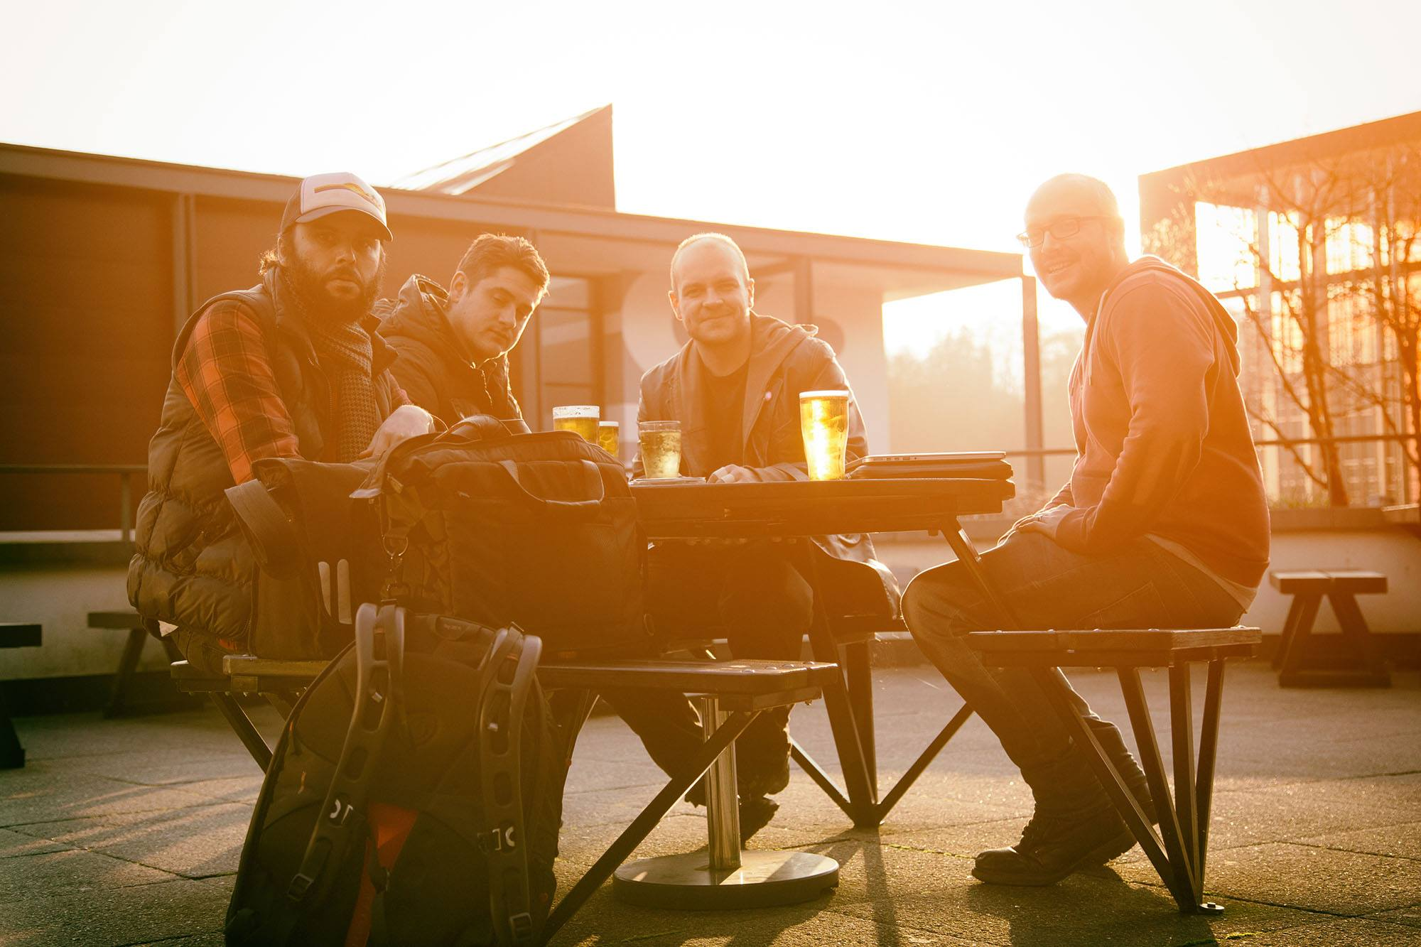
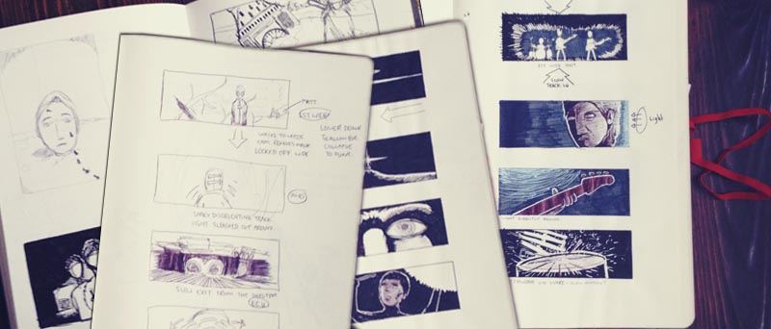
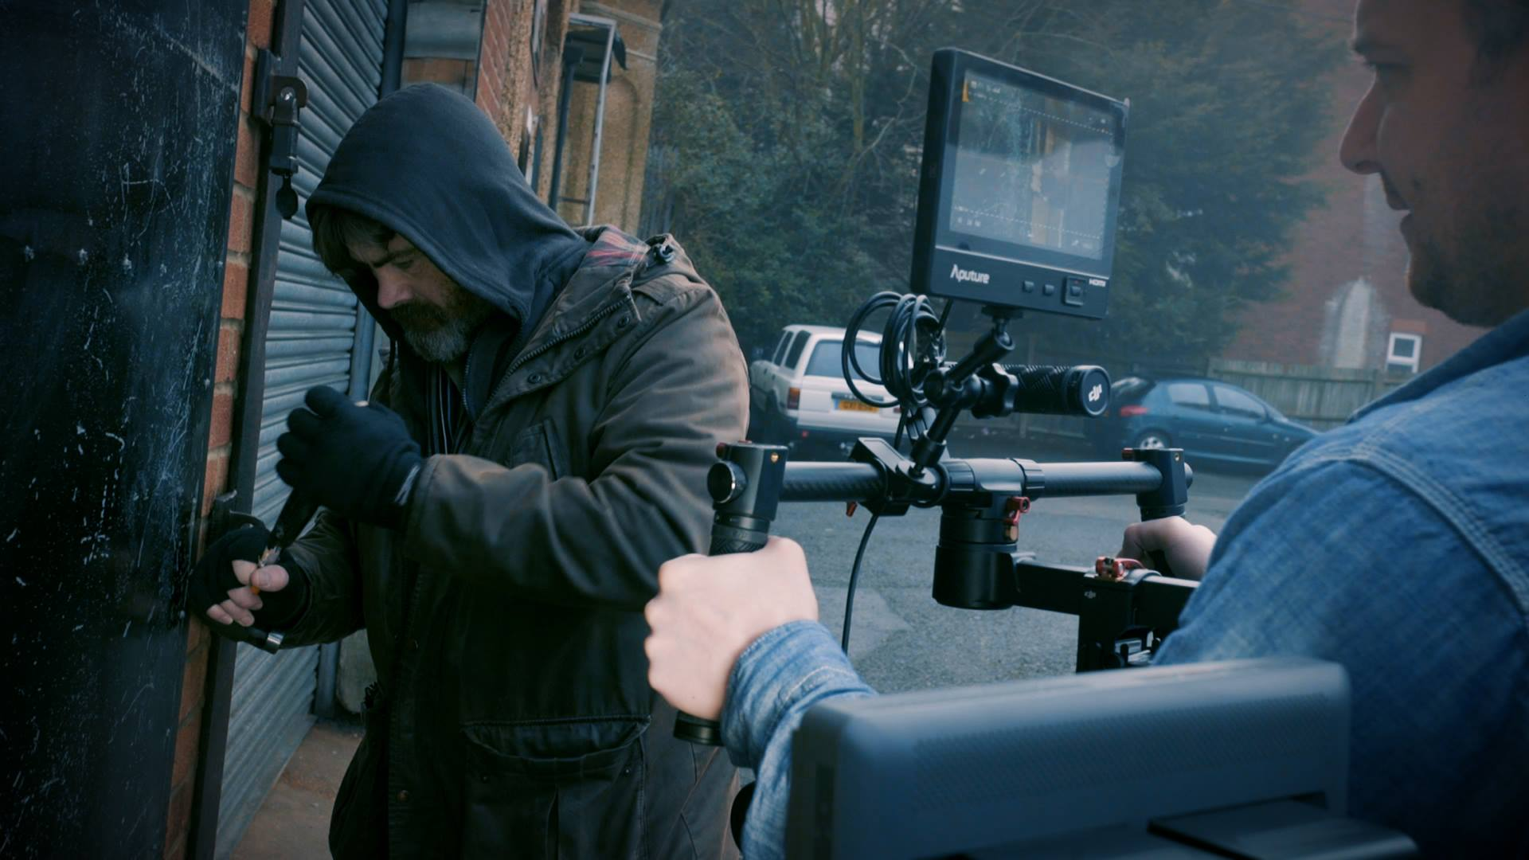
MAKING A MUSIC VIDEO - THE PROCESS
Client Contact
  Email, call, text, FB messenger, Instagram,
Discuss
  Grab a beer, email, call…
  Document everything and create a statement of work SOW / brief and both you and the artist sign
Pre Production
  Location scouting, recce and hire
  Storyboard and shot list approved by artist
  Crew hire, actors, extras and additional talent
  Set dress, specialist equipment hire or build
Production
  Usually a day or half a day
  Kit locked in day before: batteries charged, all kit prepped
  Location dressed day before if required
  Footage backed up from media to hard drives directly after shoot
Post production
  Edit first assembly, send to artist for feedback.
  Edit fine cut, send to artist for sign off or final feedback.
  Deliver web ready (MOV or MP4) and Broadcast version with slate.
Repeat.

Slide 4
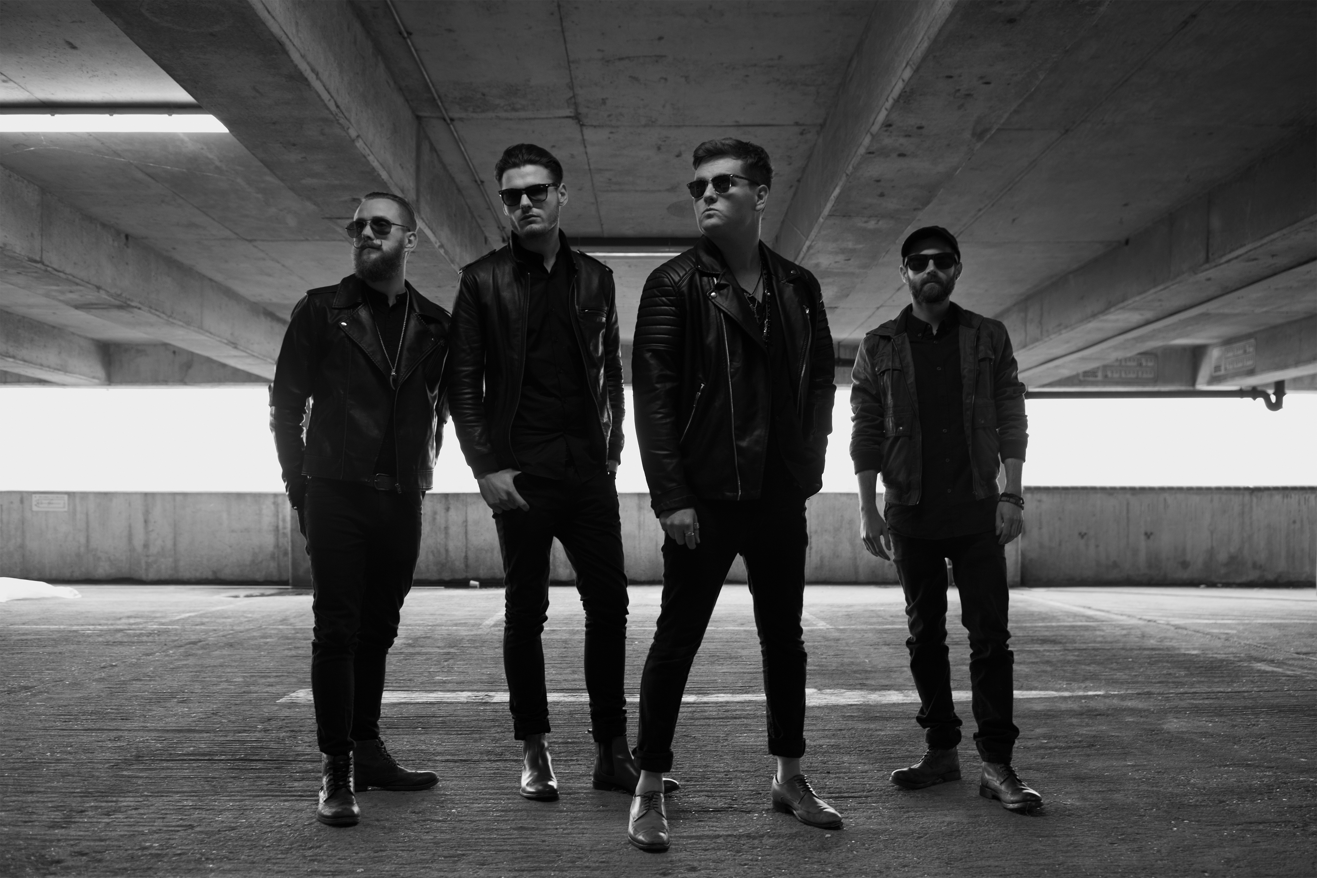
WORKING WITH TALENT
Watch performance before you roll camera.
This video will be forever, make those 4mins count.
Bands aren’t actors, but they are performers so get their absolute best performance.

Slide 5
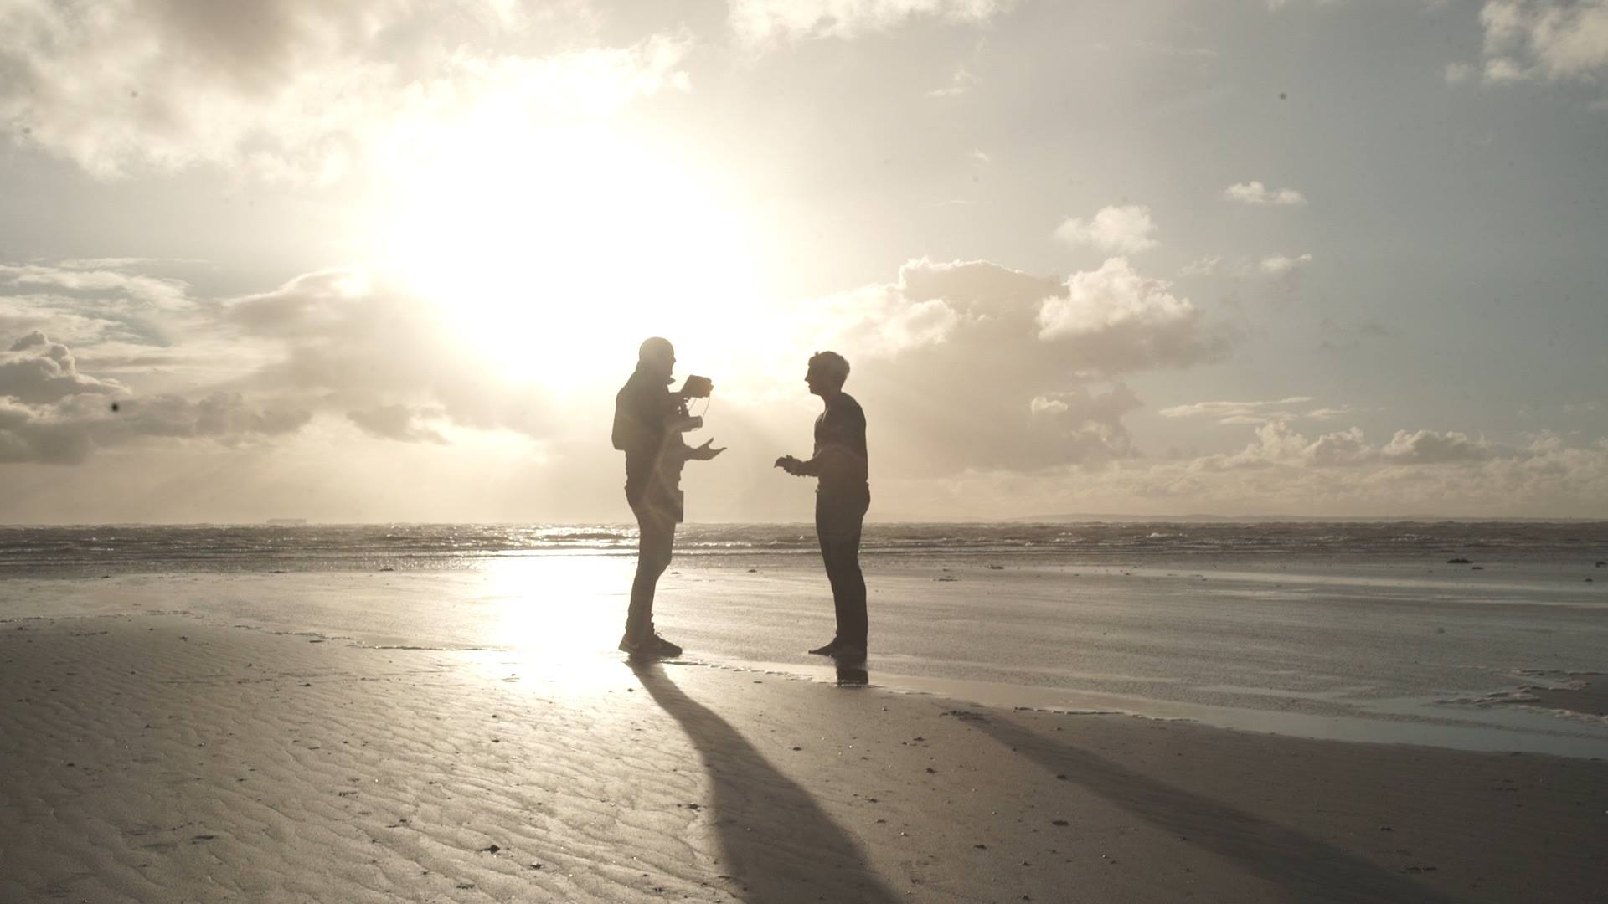
ONE MAN CREW
Pros / Cons
Lower cost / Smaller budgets
Full control / More responsibility
Light and maneuverable / More work, less hands

Slide 6
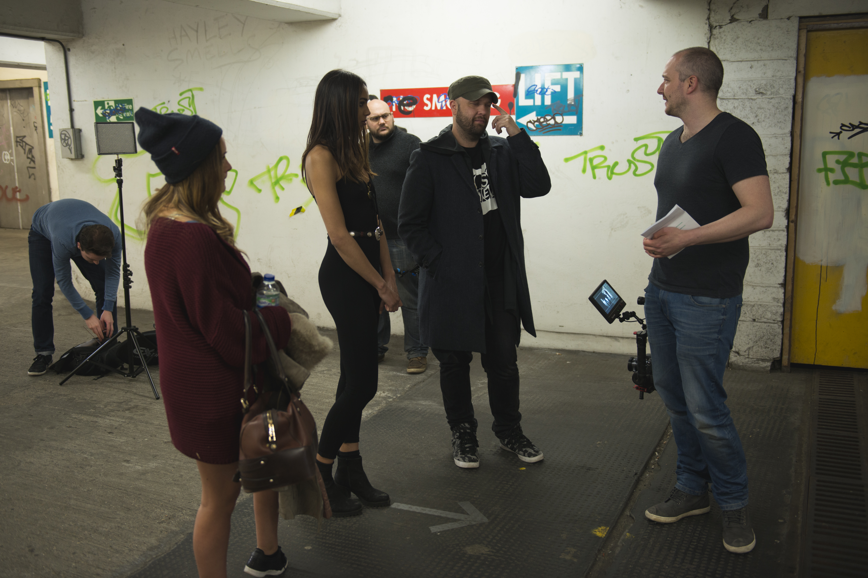
LARGER CREWS

Slide 7
LARGER CREWS
Pros / Cons
Bigger budgets / more outgoings
Spread the workload / manage workload
Bigger team, bigger vision /
More time required on set

Slide 8
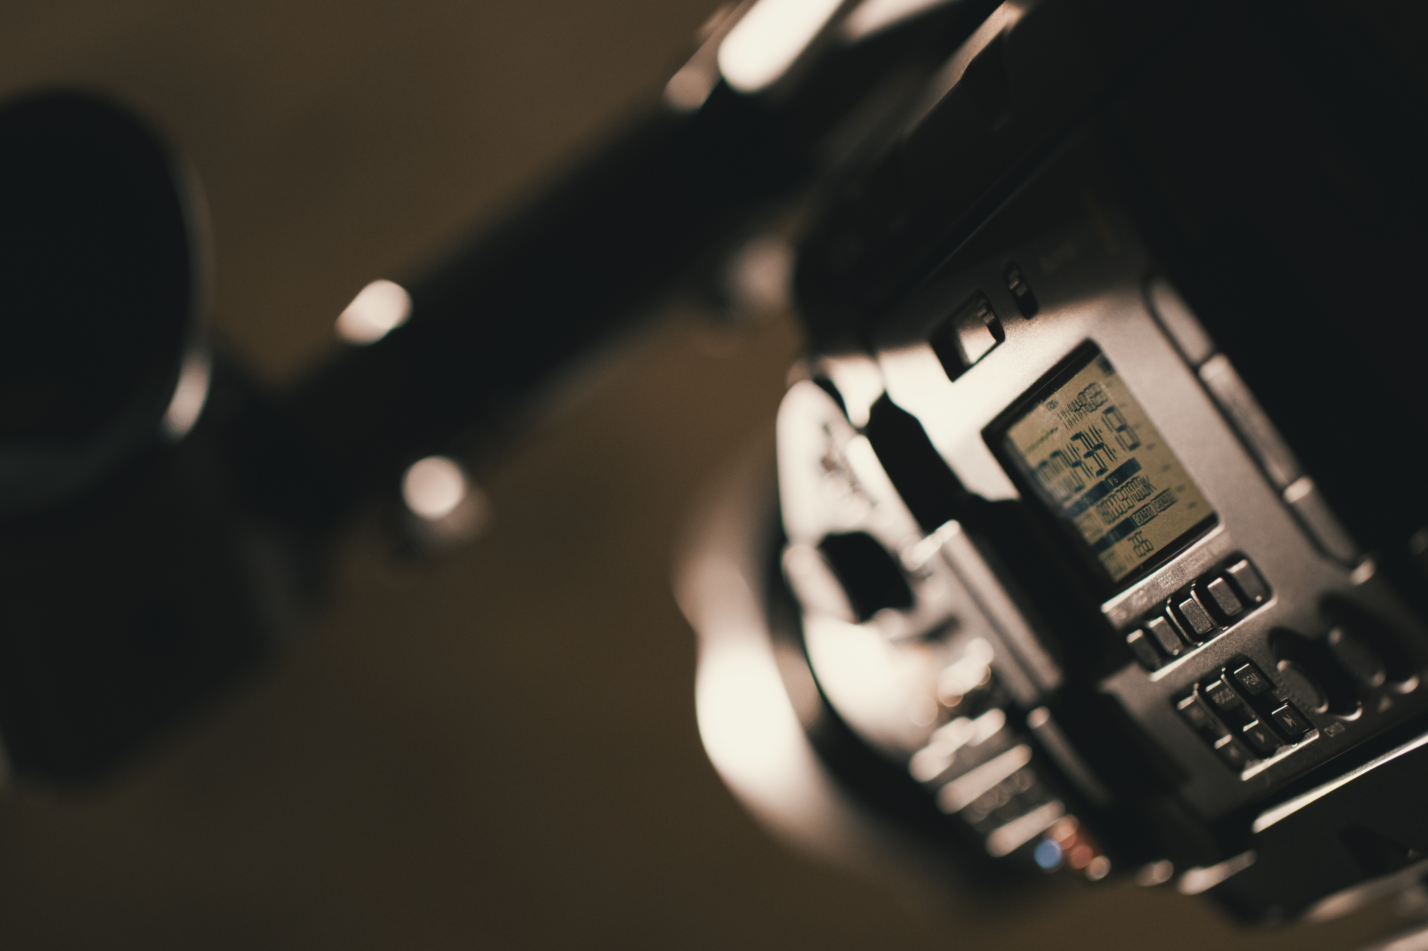
EQUIPMENT
Cameras
Ursa Mini Pro, GH5, GH4, Sony A7s
Lighting
Aputure LEDs, Photon Beard Red Heads, gels, diffusion, reflectors
Support
DJI Ronin-M Gimbal, Manfrotto 504 Fluid head Tripod + Legs, Kessler Pocket dolly slider, C-stands, grip gear
Aerial
DJI Phantom 4 Pro Drone
Audio
PA for location sound, large portable bluetooth speakers for exterior location sound
Edit Suite
Mac Pro, Macbook Pro, Davinci Resolve, Premiere Pro, After Effects, C4D.

Slide 9
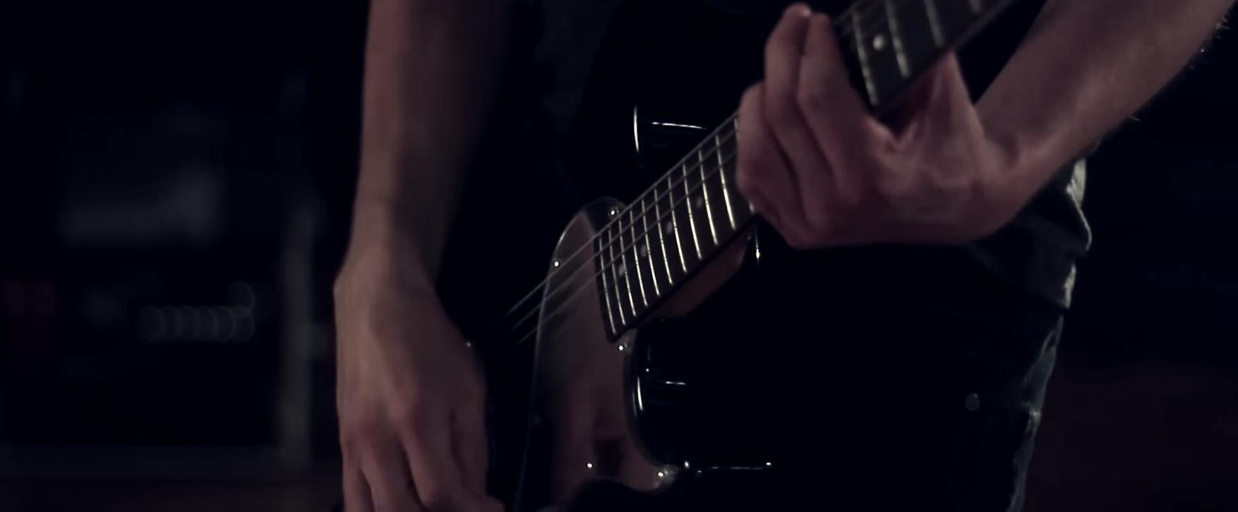
BUT REMEMBER…
First music video shot on:
Consumer DSLR Canon 550D - £500
Hired Red and Blonde light Kit - £80
Edited on a cheap PC - £400
Aired on Kerrang TV, BBC and MTV

Slide 10
THE MINDSET
STRONG IDEA / CLEAR GOAL
PLAN WELL
EXECUTE EVEN BETTER
STAY FOCUSED
STAY PASSIONATE

